Slide 1

Dharma Vahini
Stream of Righteousness
SATHYA SAI BABA

Slide 2
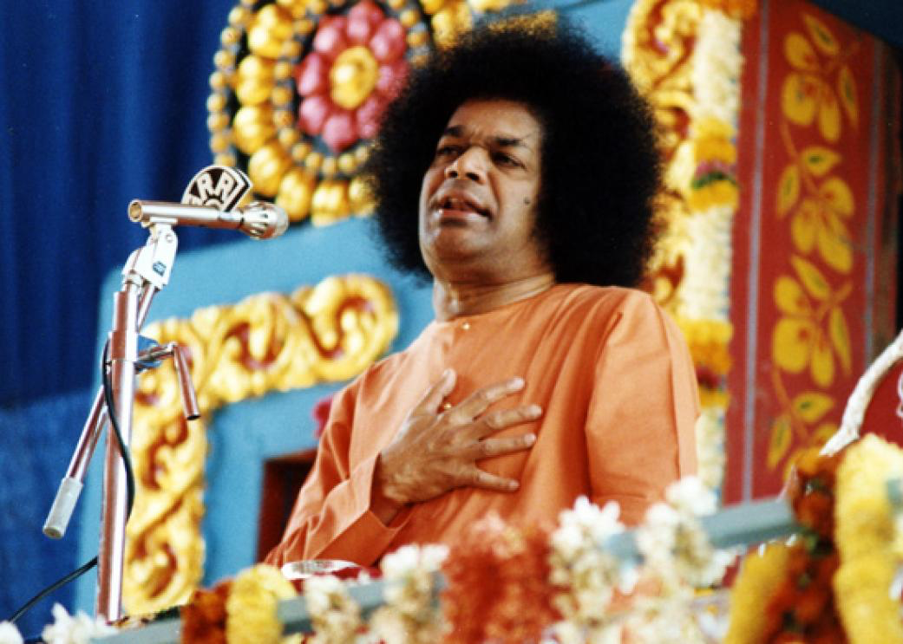
Chapter I. What Is Dharma?
Dharma is the foundation for the welfare of humanity; it is the truth that is stable for all time. When Dharma fails to transmute human life, the world is afflicted by agony and fear and tormented by stormy revolutions. When the effulgence of Dharma fails to illumine human relationships, humanity is shrouded in the night of sorrow.
People must dedicate themselves to Dharma and always be engaged in Dharma, so that they may live in peace and the world may enjoy peace. One cannot acquire real peace, nor can one win the grace of the Lord, through any means other than the Dharmic life.
Swami says God is the embodiment of Dharma. In the scriptures of the various religions, Dharma is elaborated.Dharma is applicable not only to humans but all of creation. Plants, Birds, Animals and Nature have to adhere to Dharma.
Discussion points:
What does Dharma mean to each one of you
Who do you think has failed to adhere to their own Dharma – Humans or Animals, Plants, Nature
  Think about a world without human activity and over exploitation of natural resources
  Animals & plants take only what’s needed for their survival
https://www.youtube.com/watch?v=2IDn5IYaLuw

Slide 3
Dharma is misunderstood
As soon as dharma is mentioned, the ordinary person takes it to mean: giving alms, feeding and providing lodging to pilgrims, adherence to one’s traditional profession or craft, law-abiding nature, discrimination between right and wrong, the pursuit of one’s innate nature over the freaks of one’s own mind, the fruition of one’s fondest desires, and so on.
Path of Dharma
Whoever subdues egotism, conquers selfish desires, destroys bestial feelings and impulses, and gives up the natural tendency to regard the body as the self that person is surely on the path of dharma; that person knows that the goal of dharma is the merging of the wave in the sea, the merging of the self in the Over-self.
In all worldly activities, be careful not to offend anyone or the canons of good nature; do not play false to the promptings of the inner voice; be prepared at all times to respect the appropriate dictates of conscience; watch your steps to see whether you are in someone else’s way; be ever vigilant to discover the truth behind all this scintillating variety. This is your entire duty, your dharma.
Discussion points:
What Sadhanas can we take up to install our minds in the Path of Dharma
How can we practice Dharma in our worldly interactions - brainstorm
Chapter 1 link https://www.sssbpt.info/vahinis/Dharma/Dharma01.pdf

Slide 4
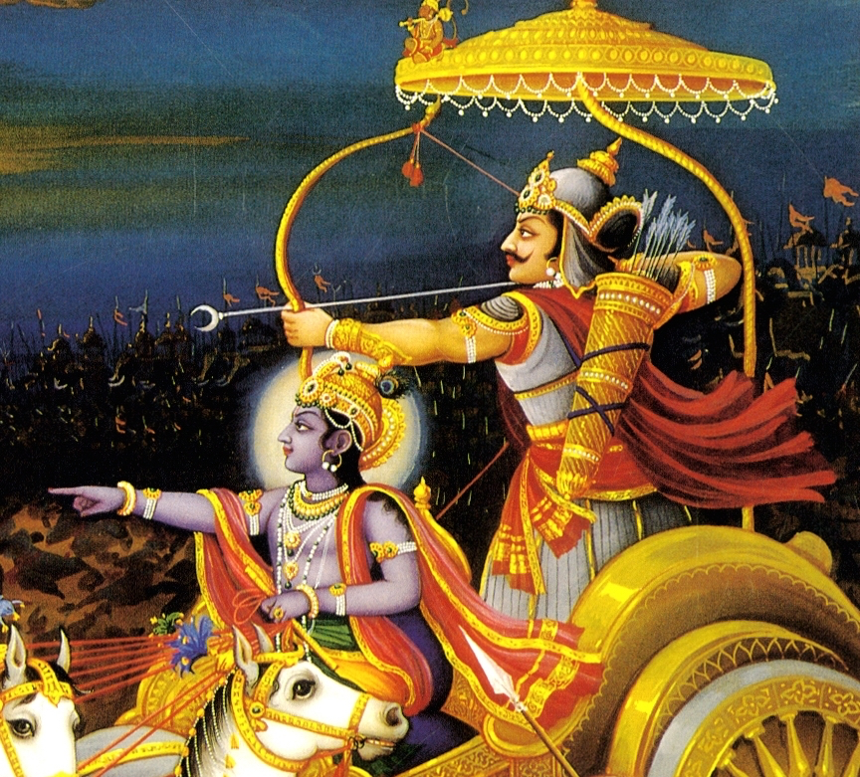
Chapter II. Divine Versus Worldly Dharma
Dharma cannot be restricted to any particular society or nation, for it is closely bound with the fortunes of the entire living world. It is a flame of light that can never be extinguished. Krishna taught the Gita to Arjuna, but He intended it for the whole of humanity. Arjuna was just an excuse. That very Gita is today correcting all mankind. It is not for any particular caste, religion, or nation; it is the very breath for humans everywhere.
Objective codes of Dharma relating to worldly activities and daily life, though important in their own sphere, have to be followed with the full knowledge and consciousness of the inner basic Atma-Dharma.
Swamis says, if in your daily avocations, you translate the real values of eternal Dharma into love-filled acts, then your duty to the inner reality, the Atma-dharma, is also fulfilled. Always build your living on the Atmic base; then, your progress is assured.
Discussion points:
Discuss the various types of Dharma that Arjuna in Mahabharata had to abide by – Worldly vs Divine
What are the various types of worldly Dharma that we adhere to and how can we connect these to Atma Dharma

Slide 5
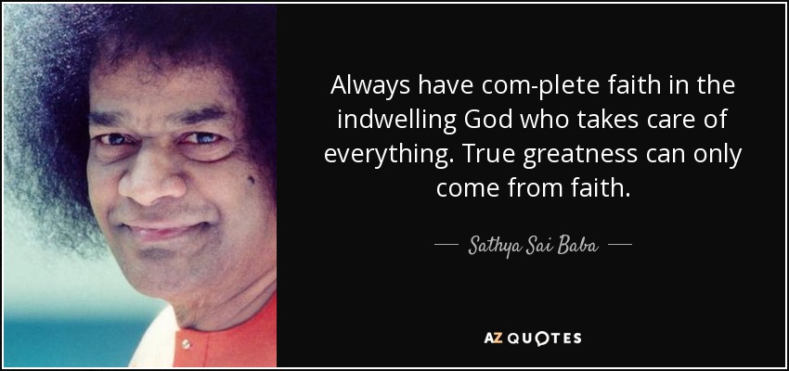
Follow divine dharma and be free
It is only when you guide your steps along the path illumined by the universal unbound dharma that you are really free; if you stray away from the light, you get bound and you are caught.
“Freedom” is the name that you give to a certain type of bondage. Genuine freedom is obtained only when delusion is absent, when there is no identification with the body and senses, no servitude to the objective world. People who have escaped from this servitude and achieved freedom in the genuine sense are very few in number. Bondage lies in every act done with the consciousness of the body as the Self, for one is then the plaything of the senses. Only those who have escaped this fate are free; this “freedom” is the ideal stage to which dharma leads.
It is only because you bind yourself that you become bound and stray away from the dharmic path. It is always so; no other person can bind you; you do it yourself. If faith in God’s omnipresence is deep-rooted, you would be aware that He is yourself and that you could never be bound!
Discussion points:
How can faith in god help us follow the path of Dharma
Personal experiences of faith

Slide 6

Egotism based on the body is hell
Sankara once said that “egotism based on the body is what is meant by hell (naraka).” Egotism of this kind is just another form of the contra-divine attitude.
Who can remove all the thorns and pebbles from the face of the earth? The only way to avoid them is to move about with footwear. So too, with the philosophy of Vedanta, with the vision fixed on the reality (sathya), with full faith in the Brahman, which is your own essential nature, you can bypass the need to transform the external world to suit your ideal of happiness and attain the practice of truth (sathya-dharma).
True dharma is the fundamental basis
The true dharma of the individual is to taste the bliss of merging with the Absolute and to attain true liberation. A person who has reached that stage can never be bound, even if put in the grimmest of prisons; on the other hand, for a person who is the slave of the body, even a blade of grass can become an instrument of death.
Discussion points:
How can Ego manifest in different forms as hindrance in the path of Dharma
True dharma is to be immersed in Atmic bliss, the inner vision, the steady faith in the identity of one’s real nature with the Absolute, and the realization that all is Brahman; these four are the authentic dharma. In this physical existence as particular individuals, these four are named truth, peace, love, and nonviolence (sathya, santhi, prema, and ahimsa)
Chapter 2 link – https://www.sssbpt.info/vahinis/Dharma/Dharma02.pdf

Slide 7
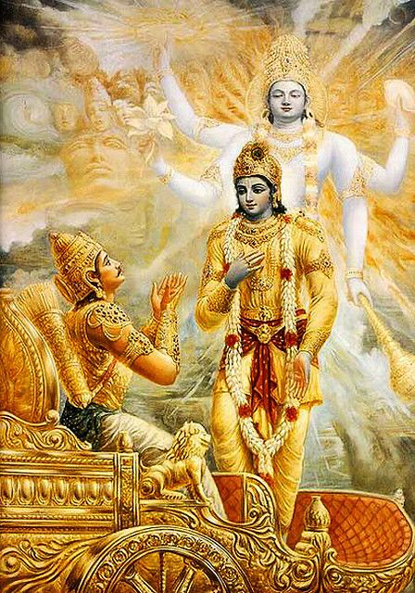
Chapter III. The Basic Flaw
You may claim that you live according to dharma, but your basic flaw is that your acts are not done in the spirit of dedication. If so done, they get stamped with the authentic mark of dharma.
Some clever people might raise a doubt and ask: “Can we then kill and injure in the name of the Lord, dedicating the act to Him?” Well, how can a person get the attitude of dedicating all activities to the Lord without at the same time being pure in thought, word, and deed? Love, equanimity, rectitude, nonviolence —these are the attendant virtues of the servant of the Lord.
To have selflessness, the spirit of self-sacrifice, and the spiritual eminence required for the dedicatory outlook, one must have first won the four characteristics of truth, peace, love, nonviolence (sathya, santhi, prema, ahimsa)
Dharma and the Gita
Brahmano hi prathishtha aham amrithasya avyayasya cha.
Shaashvathasya cha dharmasya sukhasya aikaanthikasya cha.
(I am the bliss of Brahman, of positive immortality, of timeless dharma, and of eternal bliss.) Verse in Chapter 14.
Ye thu dharmyaamritham idham yathoktham paryupaasathe. Shraddhadhaanaa Math parama bhakthaasthe atheeva me priyah.
(But those who revere this dharmic way to immortality and who completely engage themselves with faith, making Me the ultimate goal, are exceedingly dear to me.) Verse in Chapter 12
The Gita teaches Arjuna to develop certain qualities that help the practice of the Atmic dharma.

Slide 8
The Atma has no form
What you refer to as “I” and as “You” relate to the body, the appearance; they are not real (sat). The Atma is one and indivisible; dharma based on That is genuine dharma. Well, what is the form of this Atma? It is eternal, unchanging, immortal. It is goodness, right, beneficence. It is immutable, unblemished. It cannot be limited by any particular name or form. It can be understood by the spiritual wisdom (jnana) that dawns in and through the body, i.e. as acquired as the result of activity (karma-deha). The body alone has name and form, so, in every activity of the body, you should manifest the dharma based on Atma-consciousness (Atma-dharma). The sum and substance of all this is that the Atma is the Absolute, the highest goal (paramaartha).
Dharma based on caste (varna), dharma for a householder (grihastha), dharma for a forest dweller (vanaprastha), dharma for a renunciate (sanyasa), dharma for a student (brahmacharya), this dharma, that dhar- ma —all are modifications of the basic dharma. The separate varieties disappear as soon as you go deep into their nature; the corporeal dharmas fade away, and only dharma according to the Atmic consciousness (Atma-dharma) remains.
Dharma is the moral path; the moral path is the light; the light is bliss (ananda). Dharma is characterized by holiness, peace, truth, and fortitude. Dharma is yoga, union, merger; it is truth (sathya). Its attributes are justice, sense control, sense of honour, love, dignity, goodness, meditation, sympathy, nonviolence; such is the dharma that persists through the ages. It leads one on to universal love and unity. It is the highest discipline and the most profitable. In the Bhagavatha too, it is said, “where there is dharma, there is Krishna; where there are both dharma and Krishna together, there is victory.”
Chapter 3 link – https://www.sssbpt.info/vahinis/Dharma/Dharma03.pdf
Discussion points:
List the things that we do mechanically without a spirit of dedication
How can we consciously offer everything we do to the Lord thereby always embarking on the Dharmic path

Slide 9
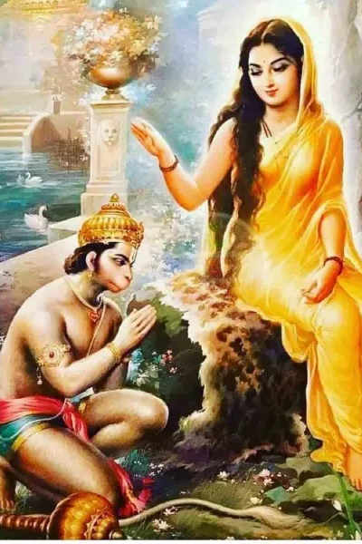
Chapter IV. Masculine and Feminine Natures
The chief guides of living
The dharma for the male and female are important applications of the dharmic truth. They connote creation (prakriti) and God (Paramatma), gross and subtle, inert and conscious, the all-pervading duet.
Dharma for women
The Feminine Principle is spoken of as the illusion imposed upon Himself by the Lord, as the energy with which He equipped Himself out of His own will. This is maya, the feminine form. This is why woman is considered the embodiment of the highest energy (Parasakthi Swarupa).
Women, who are the repositories of the embodiment of energy (sakthi swarupa), are in no way inferior. How full of fortitude, patience, and love is their nature! Their self control is seldom equalled by men. They are the exemplars and leaders for men to tread the spiritual path. Pure selfless love is inborn in women. Women who are full of knowledge, who are cultured, who are bound by love, and who are keen on discriminating whether their words and deeds are in conformity with dharma —such women are like the goddess Lakshmi, bringing joy and good fortune to the home.
Discussion points:
Discuss Mother Sita’s Dharma in Ramayana
Discuss Draupadi’s Dharma in Mahabharata

Slide 10
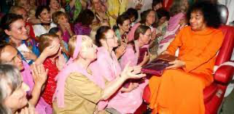
Woman: The support of home and religion
Woman is the support and pillar of the home and religion. She plants and fosters religious faith. Women have natural aptitude for faith and spiritual endeavour. Women with devotion, faith, and meekness can lead men on the Godward path and the practice of holy virtues. She is truly the representative of divine energy (sakthi). Women should strive to achieve the knowledge of the soul and live every moment in the consciousness of her being only the Atma; she must evince always a desire to become one with the divine consciousness.
Spirit of Sacrifice Is Found Only in Women
A mother is ready to sacrifice everything, even her life, for the sake of her child. Such a spirit is to be found only among women. If a child is grievously ill, the mother will try to save the child at any cost. It is for this reason that woman is described as Thyagamurti, the embodiment of sacrifice. Men do not have the same spirit of sacrifice as women. Men may present a heroic pose but do not have the determination and perseverance to carry on the struggle to the end.
Discussion points:
According to you what is a woman’s dharma ?
Discuss the different sacrifices that women make for the sake of their homes, society, nation.
https://www.youtube.com/watch?v=h6ibdzckdIQ
Chapter 4 link – https://www.sssbpt.info/vahinis/Dharma/Dharma04.pdf

Slide 11
Chapter V. Education for Women
Education is necessary for both men and women. But education for women has to be in accordance with their special needs. Educated women are really the promoters of dharma for the whole world. Parents must also cooperate in equipping women with proper education. Education (vidya) must be built on the basis of discrimination (viveka).She can master any subject related to the objective world that is prominent today, but the welfare of the spirit should not be forgotten; she must get interested in Vedantic study, which cultivates the inner vision.
Progress is based on proper education for women
The progress of the nation, the community, and the family depends on the proper education of women. The country can be lifted to its pristine greatness only through women mastering the science of realization of the Reality (Atma-vidya). If the nation is to have lasting prosperity and peace, women have to be trained through an educational system that emphasizes moral conduct and moral qualities. The cause for the present fall in moral standards and absence of social peace is the neglect of this aspect of women’s education.
Discussion points:
Is today’s secular educational enough for women or anyone to tread the path of Dharma and Spiritual progress
What changes would you bring to the educational system which can benefit all.
The education of today is spoken of as vidya, but that is merely a way of calling it. It doesn’t deserve that name, if you consider the present actions of the educated and their personality traits. The educated person must be capable of imbibing the inner joy of the Atma, regardless of external circumstances; that person must have grasped the purpose of existence and must be aware of the discipline of realization.

Slide 12

Study and society not harmful in themselves
Educated women can do useful service to the community around them according to their skill, taste, inclination, desire, character, educational status, mode of living, discipline, or scholarship. But they should avoid tarnishing the reputation of their parents, their family, or themselves. If they are endowed with good qualities and if the good qualities are accompanied by good actions, good habits, and adherence to the eternal (sanathana) dharma and spiritual discipline, then their study is really worthwhile and society is indeed benefited. Study and society are not harmful in themselves; they react with the nature of the people who make use of them and yield good or bad results.
Adhere to the dictates of dharma
Whatever subject a woman might have studied and mastered, whatever the degree she has won, whatever the status of her husband or of herself, she must hold fast to these truths: real charm consists in good character, morality is the very breath of woman, modesty is the very life force, and adherence to truth is her daily duty.
In the religious, moral, and physical fields, she must adhere to the strict dictates of dharma and take that as the essence of all education (vidya). She must be prepared to sacrifice even her life for the sake of maintaining honour; she must nourish and preserve her chastity. This is the chief dharma of woman. This is the reason for her very birth as woman.
Chapter 5 link – https://www.sssbpt.info/vahinis/Dharma/Dharma05.pdf

Slide 13
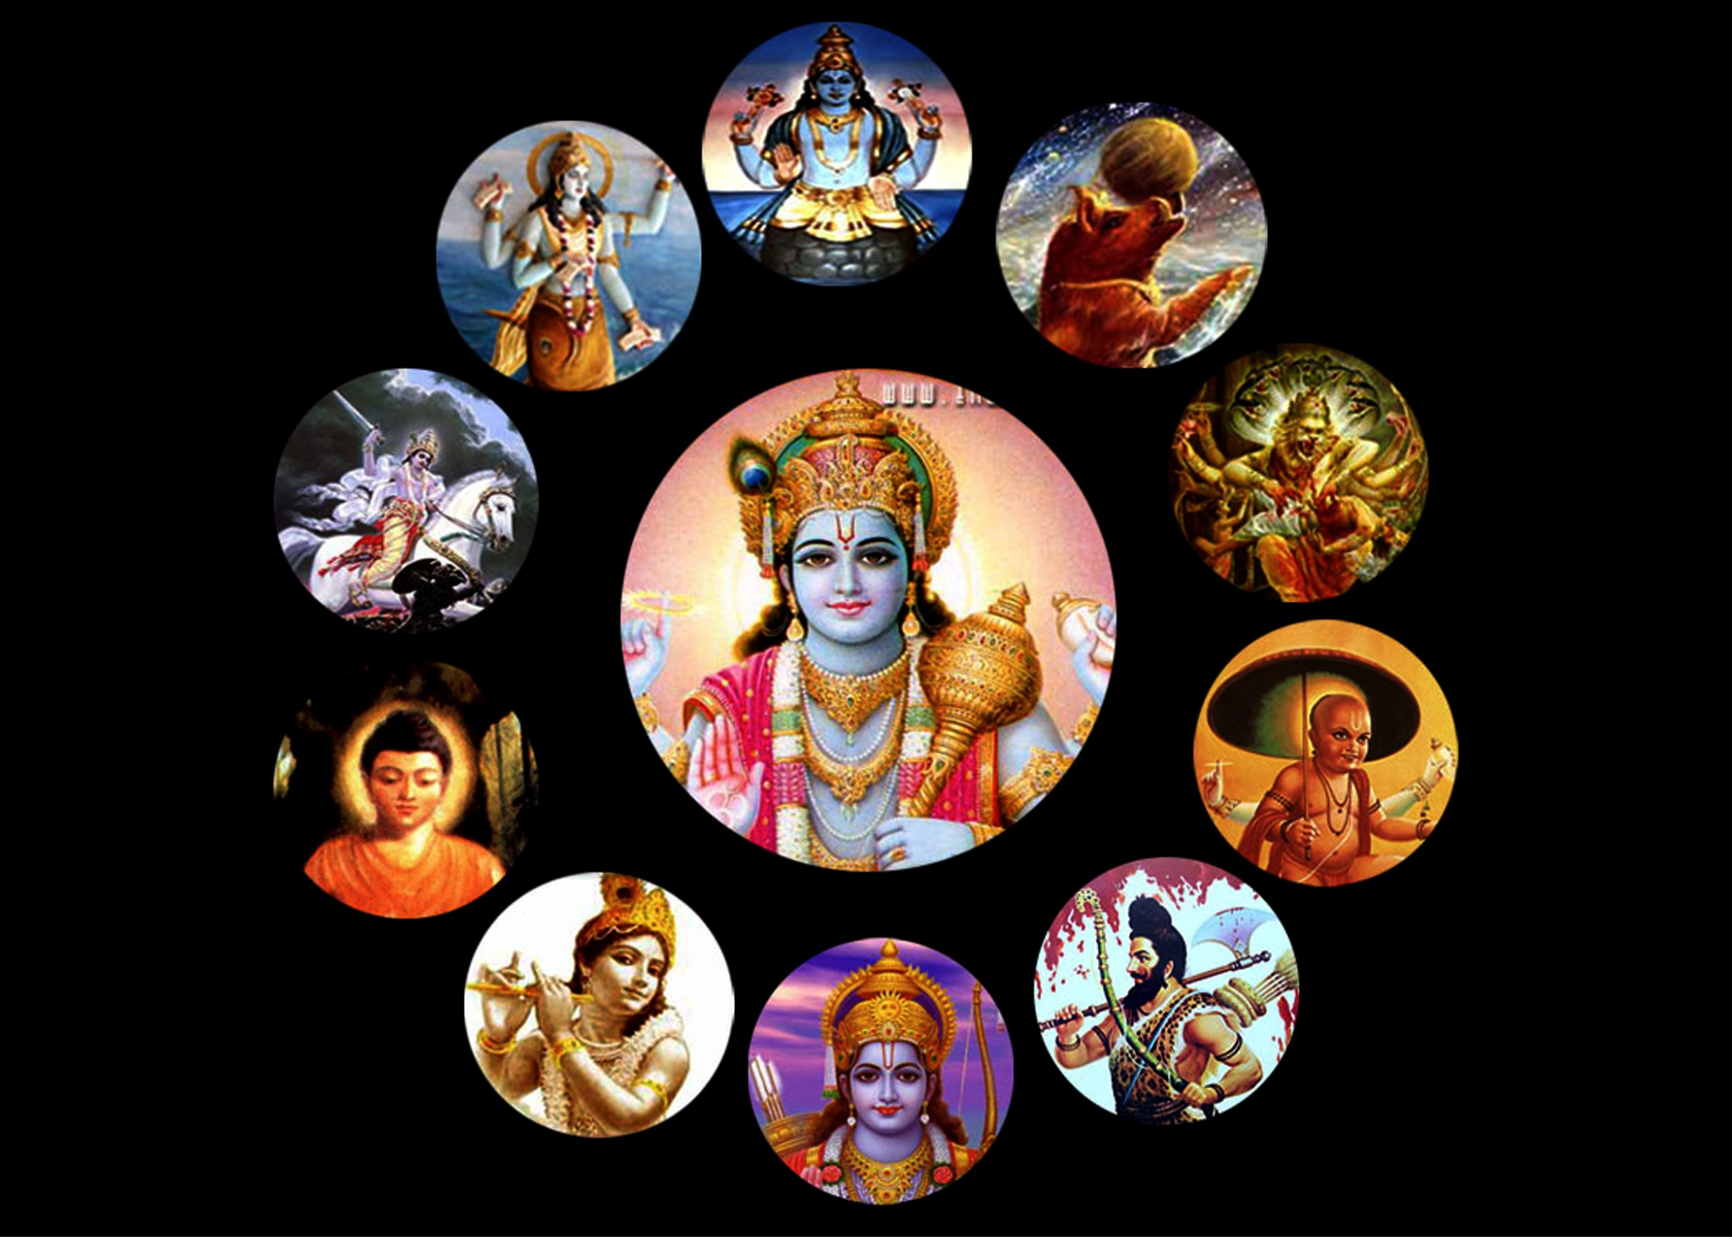
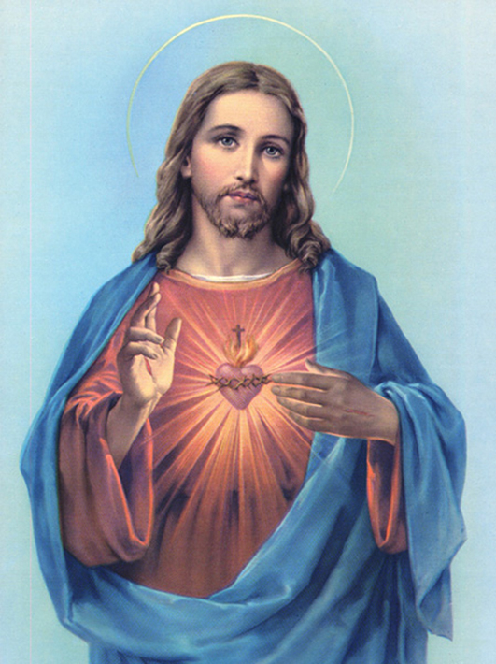
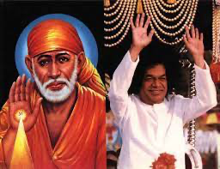
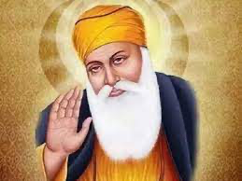
Chapter VI. Practice Dharma!
The principles of dharma will not change to suit the convenience of people. Dharma is immutable. Dharma persists as dharma then, now, and forever. Of course, the practices and rules of applied dharma might change according to changing causes; but even then, the practices have to be tested on the basis of the scriptures (sastras), not on the basis of advantage.
Everyone will not have the same motive or the same standard. For example, each will have a different idea of the fruits of bathing, morning and evening prayers, repetition of the name, and meditation, which are prescribed. Some people cancel repeating the Gayatri in the evenings and instead recite the thousand names (sahasranama) of Siva or Vishnu. “Perform morning and evening prayers at the proper time (kaale sandhyaa samaachareth); that is the prescription.” But, in spite of such directions, is it not a breach of dharma to cancel the evening prayers like this? Similarly there are prescriptions for every caste.
Chaathurvarnyam mayaa shrishtham guna karma Vibhaagashah
I created the four castes (varnas), dividing them on the basis of quality and activities.
The protection of dharma
The Lord comes down now and then to uplift the downtrodden and to reestablish dharma. This is the reason for the incarnation of the Lord, as has been said in ringing tones in the Gita.
Dharma samsthapanaarthaaya sambhavaami yuge yuge.
I create myself for the establishment of dharma in every age.

Slide 14
Falling into a-dharma
Dharma is not an ordinary affair. One who does not practise dharma is as bad as dead; one who practises it is of the divine nature. Now, there is need to turn people onto the dharmic path by means of the traditional methods of good advice, tempting them with the attractive consequences of following the path.
In ancient times, people never gave up the practice of dharma, even when threatened with death at the point of the sword. Now, without even the slightest pressure from others, people slide down and fall into a- dharma. Indeed, dharma is interpreted in various confusing ways, and those who strictly follow the real dharma are obstructed, laughed at, and treated as worse than dried-up grass. Those who anxiously adhere to dharma are branded as cheats, hypocrites, and ignoramuses.
Nowadays, many educated persons immersed in Vedic and scriptural (sastric) knowledge and classic schol- arship have lost faith in the texts of which they are masters. They have become afraid to stick firmly to dharma, for it is laughed at by their cynical friends, They have yielded to the crooked arguments of critics and sold their heritage for trivial returns.
Veda Vyasa said:
Discussion points:
Discuss the different avatars and what was their objectives in their mission on earth ? How did they contribute to restoring dharma ?
In today’s world, why is it challenging to follow the path of Dharma ? Why do we people who follow the path face so much criticism sometimes even from their own families ?
Na yakshanthi, na hoshyanthi, hethuvadha vimohithah Neechakarma karishyanthi, hethuvadha vimohithah
Those who follow the path of causalism and logic, seeking cause-and-effect connection, will not offer sacrifices in the sacred fire but will involve themselves in low demeaning acts.

Slide 15
Follow dharma, as do the elements
Only by following the path of dharma or rectitude do the sun and moon revolve unerringly in their orbits. Only the call of dharma makes all divine powers adhere to their various duties and responsibilities. Only dharma keeps the five elements bound to the principles of their nature.
You should derive the greatest possible benefit from dharma and, while following it, avoid causing any in- jury to yourselves or others. You must spread the glory of dharma by making yourself a shining example of the peace and joy it gives. Do not follow the trail of dry logic; do not confuse your brain by cynicism and prejudice; do not get interested in what others do or believe in and try to reform them or correct their footsteps. Have faith in the basic Atma, which is your real truth; test all lines of conduct on that basis, whether it will hinder the process of revealing the Atma or not. In the light of that faith and that test, carry on your daily duties and rites. Then, you will never fall into error. You will also derive great joy.
Dharma for men
Just as faithfulness to the husband (pathivratha-dharma) is for women, celibacy (brahmacharya) is for men. Just as woman should consider one person and one person only as her husband, man too has to be faithful to one woman and one woman only, as his wife. There is no such thing as woman alone being bound and men being free; both are equally bound by the rules of dharma.
Discussion points:
What do you think are the differences between Dharma for Men and Women ?
Chapter 6 link - https://www.sssbpt.info/vahinis/Dharma/Dharma06.pdf

Slide 16
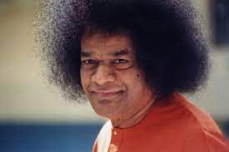
Chapter VII. Gayatri: Mother Of Mantras
The Gayatri has six categories. The categories are speech, objects, world, body, breath, and heart (vaak, bhutha, prithvi, sarira, prana, and hridaya). The Supreme Being that is extolled by this Gayatri is indeed exalted, sacred, glorious. It is impossible to grasp the mystery of that splendour-filled form. This Supreme Being indicated by the Gayatri is indeed referred to as Brahman.
One should clearly grasp the sense of the Gayatri Mantra. It is necessary to feel the identity between the effulgent Being (Atma-swarupa) mentioned therein and oneself. Only those who are ignorant of its meaning will neglect the Gayatri. Manu states that brahmins won’t lose status as long as they hold on to the Gayatri and are inspired by its meaning;
The real meaning of Gayatri
Well, what is the real meaning of the word Gayatri? Does anyone try to know it today? The word is taken to mean either a Goddess or a formula. Gayatri is that which protects (thra) the life breaths (gayas or pranas) or the senses (indriyas), beginning with speech.
Swami chanting Gayatri –
https://www.youtube.com/watch?v=w8HtbFugrW8
Swami explaining Gayatri –
https://www.youtube.com/watch?v=NO8g38VDRGg
Discussion points:
How can we make Gayatri chanting a daily part of our lives
Chapter 7 link – https://www.sssbpt.info/vahinis/Dharma/Dharma07.pdf

Slide 17
Chapter VIII. The Householder Stage
The stages of life (asramas) regulating man’s life are four: student, householder, forest dweller, and renunciate (brahmacharya, grihastha, vanaprastha, and sanyasa). They are all based on the householder stage of life. That is the chief stage, because the householder fosters the other three. The householder is the most important of all. There is no doubt that everyone who adheres to the dharma of their stage of life, no matter which stage it is, will attain liberation.
All four stages lead to liberation
Doubt may arise whether one can adopt the householder stage of life, which is the base and support of all, or whether one has to take up the universally honoured stage of renunciate, the inward path of detachment (nivritti). There is an intimate relation between the worship-worthy householder and the saintly sage (paramahamsa). So, to whichever stage of life you may belong, you do no wrong. All four stages will lead you to liberation (moksha) if you follow strictly the dharma as laid down for each and devote yourself steadfastly to your uplift. Each stage is important at that stage; the conduct of the individual, their practice, that is the essential test. If one is engaged in good conduct, every stage is holy and commendable.
Adhere strictly to dharma
The great sages who grasped the divine dharma (Atma-dharma) declared that being, awareness, and bliss (sat, chit, and ananda) are the basic characteristics of the Self. How to get that clear vision? The answer is through the practice of dharma, the dharma that is conditioned by caste and stage of life! Dharma enables the Atma to be realized, without any mist or fog hiding it from view. The practice of dharma fills you with experience; through that experience, truth is established; the truth reveals clearly, and the vision grants liberation. People who are free from such inner encumbrances hiding the Atma may belong to any caste or stage of life; that does not matter; they do attain liberation.

Slide 18
Harmony in the household
Moved by the desire to cross this ocean of worldly existence (samsara), the husband and wife must both have harmony of mind.
There is no rule that people should become renunciates and flee when they meet with difficulties in the spiritual field at home. It can never be fruitful for the husband to become a renunciate without full approval of his wife. The best that he can do is to leave home with his wife and be a forest dweller (vanaprastha), adhering to the dharma of that new stage. If there are children who need attention and care, even forest-dwelling at that stage is not favoured by the scriptures.
One has to make the children independent of one’s care and then leave them to themselves. The scriptures (sastras) therefore require that a person has to be in the householder stage till the age of 48, whether it is favourable or not. One has to be in it and struggle to perform one’s duty (swa-dharma), without hindrance. If hindrances come, dedicate them too to the Lord, take them quietly as His play (leela) and as His plan; that is the way to follow the householder discipline, the path for both men and women.
Discussion points:
In today’s busy world and lives, it is almost impossible for everyone to go to a far away quiet place to practice their Sadhana, progress spiritually to attain the goal of self realization. But Swami has clearly mentioned, one need not do that. Swami says: Hands in the society , Head in the forest.
How can we put this into practice ?
Chapter 8 link – https://www.sssbpt.info/vahinis/Dharma/Dharma08.pdf

Slide 19
Chapter IX. All May Seek Spiritual Wisdom
High and low, rich and poor, male and female —all are affected by illness, and all have the right to seek the drugs that cure illness. So too, all people are affected by the illness of birth and death and all have the right to the drug, named knowledge of Brahman (Brahma-vidya), that is its effective cure.
The drug, Brahma-consciousness, has to be supplemented and strengthened by the appropriate dharma as well as by cultivation of devotion, wisdom (jnana), and discrimination (vairagya).
Practice the spiritual injunctions
A lion asleep is unaware of its nature; so too, people asleep in the coils of delusion (maya) are not aware of being the splendourful Atma. Scripture is an eye to humanity; it is the eye that leads and illumines and guides. Follow its directions —that is one’s whole duty. That is the big task before the world today. If the scriptures are fully understood, no doubt will arise, no discussion will be needed.
Classification of the four ages (yugas)
The ages (yugas) are classified on the basis of the dominant mental role. In the age of truth (Kritha-yuga), it is said that dharma walked about on four legs, happy and safe. In the second age (Thretha-yuga), dharma had only three legs, while in the third age (Dwapara-yuga), it had to totter about on just two! In the present Kali-yuga, dharma has only one leg, according to this tradition.
The ages (yugas) change only with the change in dharma, not with the mere passage of time.
Discussion points:
If Yugas change only with Dharma and not with passage of time, how can we follow and implement Swami’s teaching to make this Kali Yuga , the Golden Age. What would your definition of Golden Age be ?
Chapter 9 link – https://www.sssbpt.info/vahinis/Dharma/Dharma09.pdf

Slide 20
Chapter X. The House of God
The house of God, the residence of the concretized formful aspect of Divinity, the temple (alaya or mandir) and the rules of dharma relating to it. Rules have overgrown and overwhelmed these institutions, following the whims and prejudices of various authorities. They have led people away from dharma and Brahman and even away from proper action; they have confounded the devotees by their variety and unreasonableness. The rules are insisted upon blindly, so they have done much harm to the welfare of the world itself. In fact, the rules and formalities form the first steps in the retreat away from God and have fostered atheism in great measure.
Functions of the temple
Think deeply over the functions of the temple. Temples are centres of discipline, where the aspirant is guided step by step to attain a vision of the truth. They are schools for the training of the spirit, academies for the promotion of scriptural studies, institutes of super-science, laboratories for the testing of the values of life. The purpose of the temple is to awaken the Divinity in humanity (Madhavathwa in manavathwa), inducing people to believe that the physical frames in which they live are themselves houses of God.
Temple rules should not conflict with highest conceptions of devotion
Today, on account of newfangled views, temples have become objects of derision. This is a sad state of affairs.
The rules must not conflict with the highest conceptions of the devotee. If the temple servants have no fixed timings and if everything is left to their whim and fancy, the temple will not be able to instil devotion in the mind of the ordinary man; certain limitations and regulations are needed even to arouse the awe and respect that are the roots of devotion. That is why certain hours are laid down for entry into temples and for opening the shrine for worship. Such restrictions are not repugnant to the main principle. For the aim of the temple is to promote dharma

Slide 21
Devotion is the queen
The scriptures teach that all actions and activities must lead ultimately to non-attachment, for this is the best qualification for the development of knowledge of Brahman. Of the three, devotion, wisdom, and renunciation (bhakthi, jnana, and vairagya), devotion is the queen. The rules and rites are the maids-in-waiting; the queen treats her maids with kind consideration and favour, no doubt, but if the ceremonies, which are only “servants” and “aides”, disregard the queen, they should be mercilessly dismissed. All the formalities and rituals in the temples must therefore subserve the glorification of the queen, devotion; this is the sum and substance of the dharma that must direct and govern all temples. Only then can man reach the goal.
Devotion helps the attainment of the bliss of merger with the basic Brahman most easily by canalizing toward the Lord the mental agitations, the sensory reachings-out, and the emotional urges of people. It is in this direction that all the details of the worship of the Lord in temples took shape. In the temple, all the various ceremonies, from the “awakening of God in the early dawn” to the “laying in bed” late at night, are intended to heighten and promote the devotional trends of the mind. In turn, each incident helps the sublimation of the appropriate emotion, in a peculiarly charming manner. In the sublimity of that experience, the agitation of the lower emotions declines and disappears.
Discussion points:
Today, Atheism is on the rise. Why do you think this is happening ?
What can places of worship do differently to draw people especially younger age groups to them ?
Chapter 10 link – https://www.sssbpt.info/vahinis/Dharma/Dharma10.pdf

Slide 22
Chapter XI. Three Eras
The eras, classified according to the principles and practices of spiritual progress as laid down in the Hindu dharma, are three:
1. The Vedic era, during which great importance was laid on rituals (karma).
2. The Upanishadic era, when spiritual wisdom (jnana) was emphasized more than all else.
3. The Puranic era, when devotion (bhakthi) was declared and described as all important.
The Vedic age
Vedic literature consists of hymns (samhithas), Brahmanas, forest texts (Aranyakas), and Upanishads. Of these, the first three deal with actions (karma) and are known as Karma-kanda, and the last, the Upanishads, are concerned with spiritual wisdom (jnana) and are therefore called wisdom texts (Jnana-kanda). The Aryans in ancient times earned peace and contentment and the fulfilment of their desires by sacrifices and rituals, which were addressed to these Gods through the mantras. They realized that the Absolute Principle, the Paramatma, is one and only one, and they also knew that it manifests nevertheless as varied and manifold, under different names and forms.
The simple spontaneous disciplines of the Vedic Age gradually became complex and confused by the overgrowth of rituals and formal rules; with the passing of time, it was declared that dharma consisted of ritual (yajna) and oblation (homa) and that heaven could be gained only by the performance of such rites! Though the ritual was really a method of worship of the gods, value was shifted from the gods to the ritual itself. “The gods were only the means; those who desired heaven must do rituals.” Such was the turn the declaration took.

Slide 23
The Upanishadic Age
Meanwhile, the Upanishad Age dawned. The Upanishads rejected material objectives as devoid of permanent value; they condemned them as inferior. In fact, the ritual portion (Karma-kanda) of the Vedas was transformed and revalued in the Upanishads as vehicles for the liberation of people from the bondage of birth and death and as vessels for crossing the ocean of worldly existence (samsara). The vision of the Upanishadic aspirant (sadhaka) breaks through this “external sensory objective world” and centres itself on the “inner world”.
The Puranic age
The seeds of devotion found scattered in the Vedic texts sprout in the Upanishads and begin to grow with many a blossomful branch in the Puranas. Many are yet confused when it comes to deciding what exactly devotion (bhakthi) is, what the nature of the attitude called devotion is! It is impossible for anyone to demarcate what exactly devotion is and what it is not. Devotion has infinite facets. Only pure, tender, tolerant, calm and loving souls, the very cream of spiritual aspirants (sadhus), the swans (hamsas) sporting ever in the company of kindred devotees, can understand its purity and depth.
The unmanifested quality-less Brahman cognized at the climax of the path of spiritual wisdom (jnana-marga) cannot be grasped by the sense-centred individual without great travail and trouble. This is why the Puranas dwell so much more on the with-qualities (sa-guna) aspect than on the quality-less (nir-guna) aspect of Godhead.
Discussion points:
What do you think are common between the 3 ages ?
Chapter 11 link – https://www.sssbpt.info/vahinis/Dharma/Dharma11.pdf

Slide 24

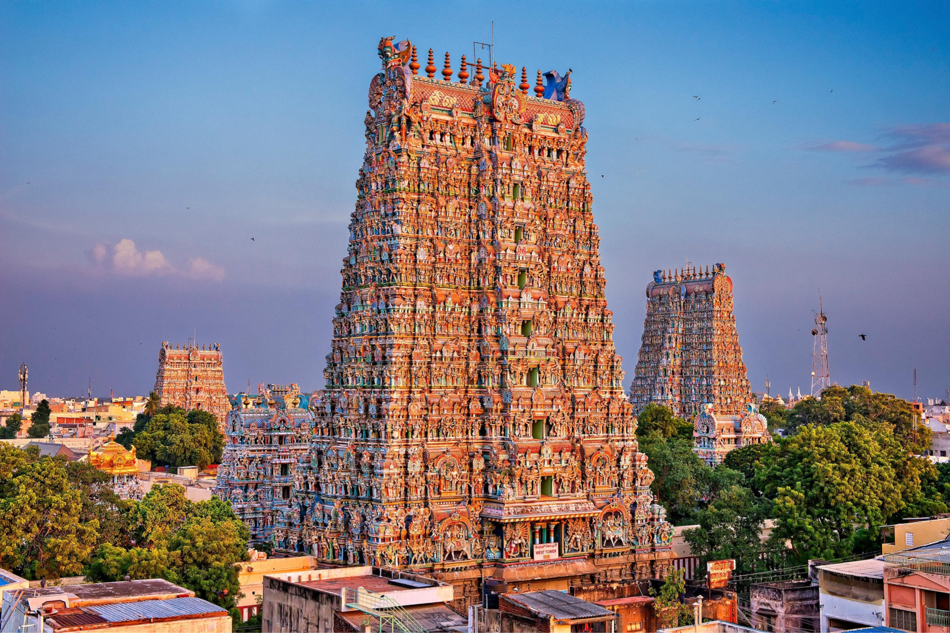
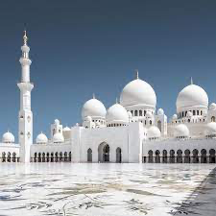
Chapter XII. Temples
The ancients considered temples not only as temples of God (deva-mandirs) but also as temples of spiritual wisdom (vijnana-mandirs). They knew that God can be attained by service done consciously and with full knowledge of meaning. They felt that temples are academies of higher learning, where man develops the real culture of the mind. They knew that the house of God in the hearts of people would be as clean and holy as the house of God was in the hamlet where they lived.
Temples are invitations to and reminders of God
Temples are invitations to that home, signboards directing people there. It is because of such reminders that the culture of India (Bharatha-varsha) has God as its central theme. “Bha-ra-tha” means the land that has attachment (rathi) to Bhagavan or God. If westerners renounced everyhing, in their single-minded devotion to the discovery of the laws that govern the objective world, here in India (Bharatha-varsha), people renounced everything for the discovery and experience of the Absolute, which is the Prime Cause of the universe and which, if known, confers unshakeable peace.

Slide 25
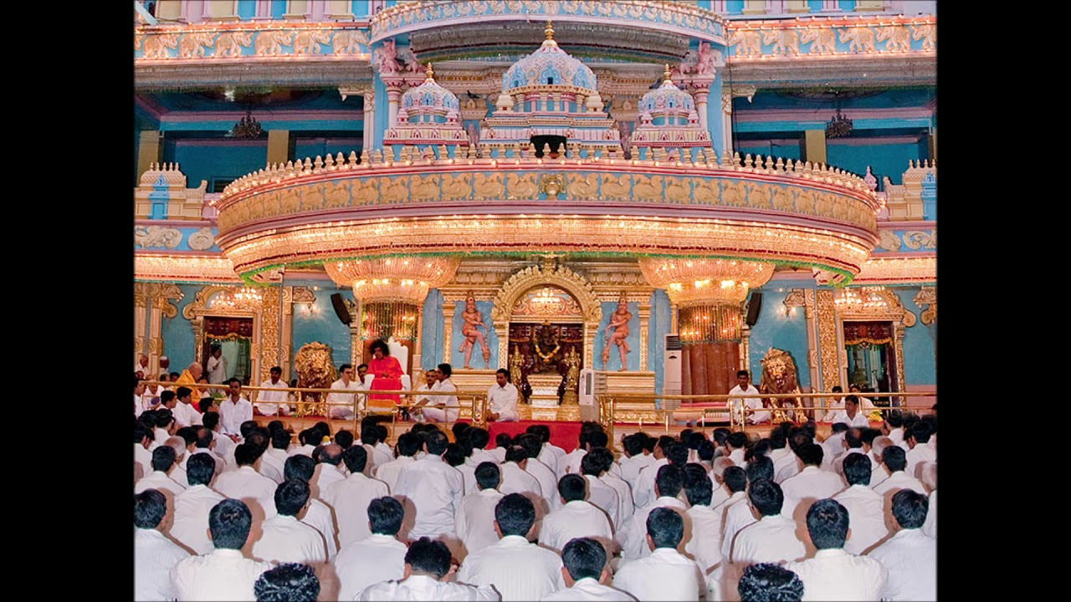
Temples are intended to instruct people in the art of removing the veil of attachment that lies over their heart. That is why Thyagaraja cried in the temple at Tirupathi, “Remove the veil within me, the veil of pride and hate.” The fog of illusion (maya) melted away before the rays of grace, so he could discern and describe the image of divine charm in the song “Sivudavo Maadhavudavo” and drink deep the sweetness of that form. The churning of his heart by the divine formula produced the spark of wisdom (jnana), and it grew into the flame of realization. Not only in this present age of Kali-yuga but even in the earlier ages (yugas), the Kritha, the Thretha, and the Dwapara, remembrance of the name (namasmarana) was the secret of liberation from bondage. The temple is the place where remembrance of the name is natural, automatic, and undisturbed. Therefore, going to it is imperative, especially in the Kali age, when the air is full of wicked and ungodly thoughts.
Seekers find temples indispensable
To misuse such temples, to spoil the sacred atmosphere of their precincts, to forget their holy mission, to decry the conventions and customs prevalent there, and to pave the way for their decline and desecration —undoubtedly, this is not dharma. Those who do these things have neither inner nor outer light; they are in utter darkness. Temple worship, the company of sages, recital of the name, adoration of the image or symbol —these are external sources of light. Meditation, austerity, reflection (dhyana, tapas, manana) —these are the sources of inner illumination.
Discussion points:
What inspires you to go to places of worship ?
How can we teach the young the importance of places of worship parallely with the omnipresence of god.
Chapter 12 link – https://www.sssbpt.info/vahinis/Dharma/Dharma12.pdf

Slide 26

Chapter XIII. The Dharmic Person
Dharma has no prejudice or partiality; it is imbued with truth and justice. So, people have to adhere to dhar- ma; they have to see that they never go against it. It is wrong to deviate from it. The path of dharma requires people to give up hatred against others and cultivate mutual concord and amity. Through concord and amity, the world will grow, day by day, into a place of happiness. If these are well established, the world will be free from disquiet, indiscipline, disorder, and injustice.
Whatever you are dealing with, you must first grasp its real meaning. Then, you have to cultivate it daily, for your benefit. By this means, wisdom grows and lasting joy is earned. The two basic things are dharma and action (karma). The wise, who are impartial and unprejudiced, who are confirmed in dharma, walk on the path of truth (sathya), as instructed in the Vedas. That is the path for all people today.
Three stages to knowledge of dharma
The knowledge of dharma is reached in three stages:
(1) You must receive training under wise people (vidwans), who are also imbued with dharma.
(2) You must aspire to attain self-purification (Atmasuddhi) and truth (sathya).
(3) You must realize the value of knowledge of the Vedas (Veda-vidya), the voice of God (Parameswara).

Slide 27
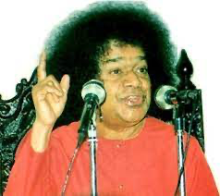
When these three are completed, then one understands the truth and how that truth is to be separated from untruth. This enquiry into truth has to be done in amity and cooperation; all must be equally eager to discover it for the benefit of all. Everyone’s opinion must be tested on the touchstone of dharma, of universal good (sarva- lokahitha). The principles that pass this test have to be specially kept apart, used, and spread in the world for the advancement of human welfare. By this means, all will develop joy and happiness in equal measure. “
“All are the same (samithih samaani)”, says the scripture. All have the same claim for spiritual wisdom (jnana) and for the means of attaining it, like education. Therefore, all must do noble and pure deeds.
Keep mind and conscience on the path
The renouncing of evil deeds, the giving up of desire —these two are accomplished by the same instrument, the mind (manas). The objectives of human life (purushaarthas) have to be gained only through that.
Remember also that both of these —the mind and the conscience— have to be kept straight on the path of welfare of all mankind (sarva-manava-sukha). Dharma will shine and illumine only in the person who serves all and confers joy on all. Such a person will receive not only the grace of the Lord but also the unique privilege of merging in Him.
The dharma person will reveal decision and enthusiastic exultation in every act of theirs. Their adherence to dharma must be of that order.
Fill every ounce of your energy with the essence of dharma and endeavour to progress in that path, more and more, with every passing day.
https://www.youtube.com/watch?v=t_V2a_8vDgM

Slide 28
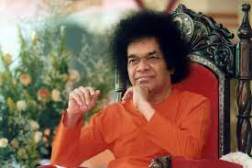
The discipline of truth (sathya)
If you are careless about the discipline of truth, every duty laid on you by dharma and every action prompted by dharma will hang heavy as a burden. Search for the reality behind all these phenomena and that search will make all dharmic actions light and pleasant. The Lord has shaped people so that they are inclined toward God and is delighted at the expansion of their vision and happy when they are moral and virtuous. So, people must serve their best interests by adhering to their basic nature, by concentrating on Brahman, by cultivating truth, and by practising dharma.
Truth has to be sought and tested by all the canons of reasoning. The discipline consists of:
The heroism to observe dharma rigorously (ojas).
Fearless self-control (tejas).
The discarding of all feelings of joy or sorrow at the ups and downs of life, with equanimity.
Having unshakable faith in truth and dharma (sahana).
Mental and physical health of the most excellent kind, earned by discipline and celibacy (bala).
The desire and ability to speak sweetly and straight, won by the practice of truth and love.
Withdrawal of the five senses of wisdom (jnanendriyas) and the five senses of action (karmendriyas) from
vice and sin and the sublimation of all the senses for the service of truth (indriya-moha).
The winning of the overlordship of all the worlds by the self-won domination of the inner world.
The destruction of one’s prejudices and the pursuit of truth at all times (dharma).
The prayer one has to make is, “May all this be conferred on me” as found in the “Chamaka hymn”.
Chapter 13 link – https://www.sssbpt.info/vahinis/Dharma/Dharma13.pdf
Discussion points: – How are Sathya, Dharma, Shanti, Prema and Ahimsa intertwined ?

Slide 29
Sairam

